Slide 1
Advanced CNN

Slide 2
Advanced
CNN
Advaced CNN

Slide 3
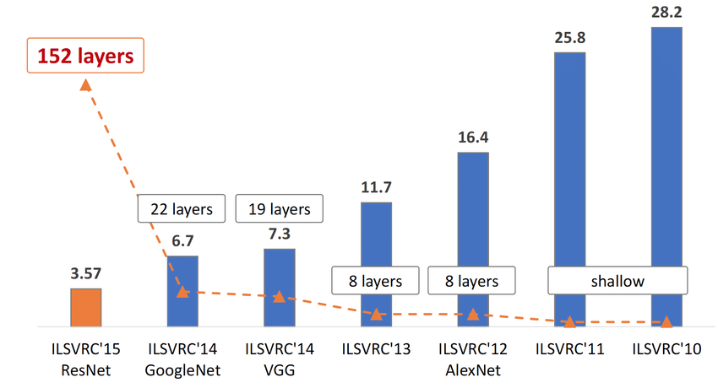
ImageNet
Challenge

Slide 4
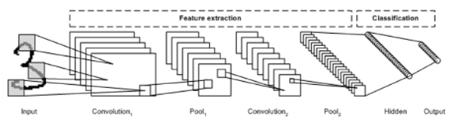
Basic
CNN

Slide 5
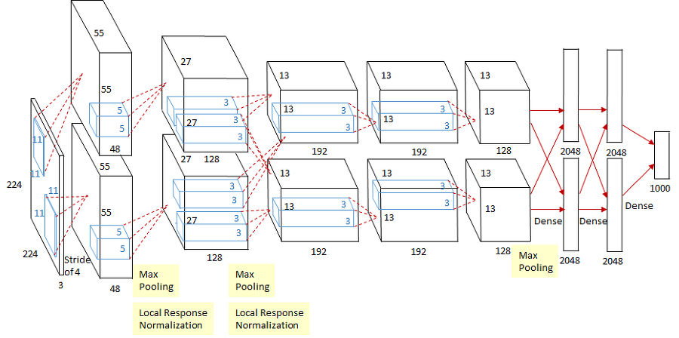
AlexNet

Slide 6
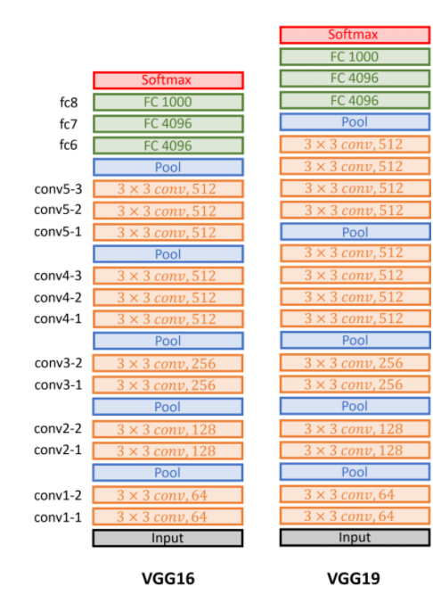
VGG

Slide 7
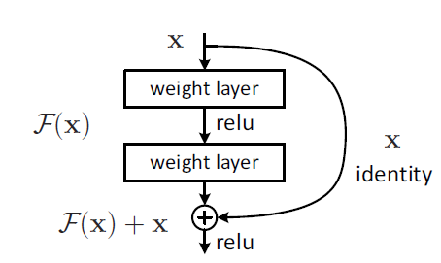
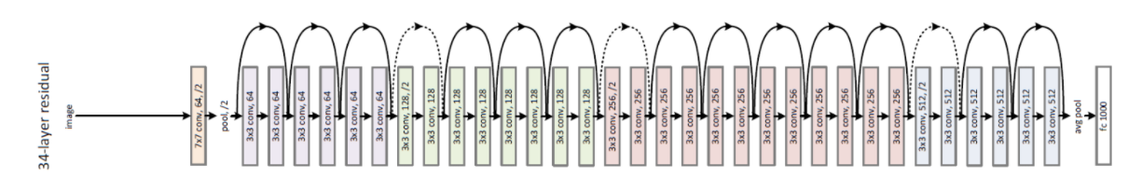
ResNet

Slide 8
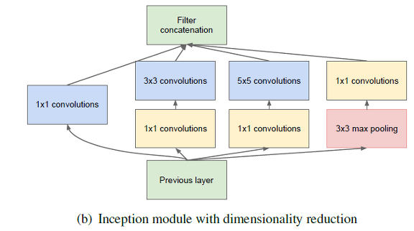
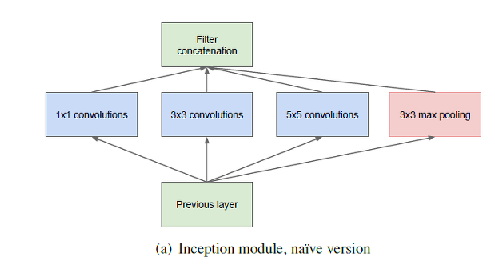
GoogleNet

Slide 9
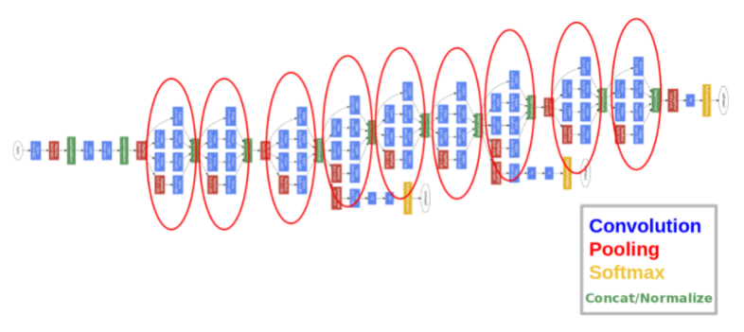
GoogleNet

Slide 10
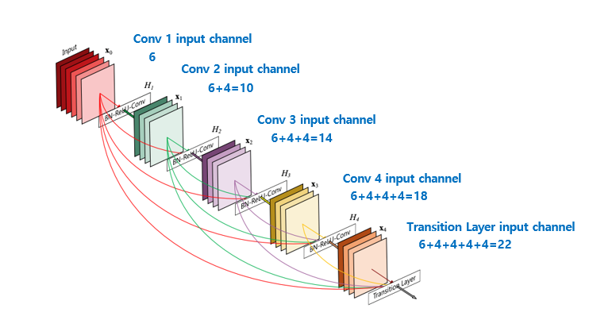
DenseNet

Slide 11
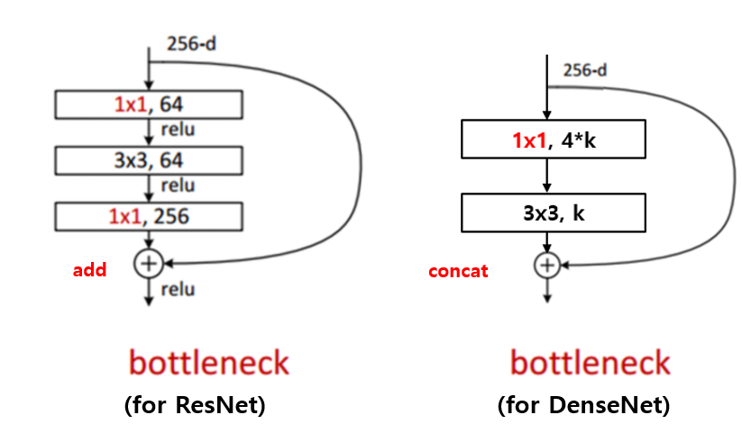
DenseNet

Slide 12
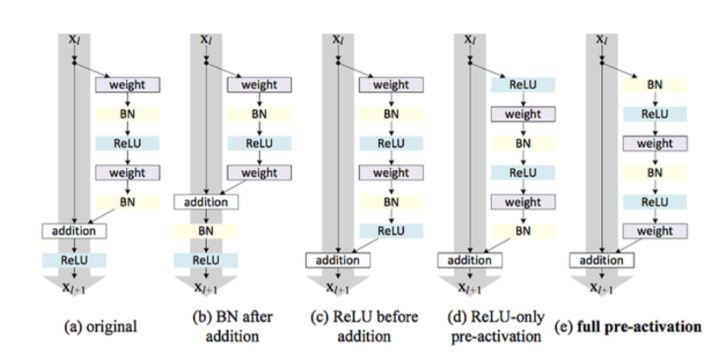
DenseNet

Slide 13
DenseNet
Transition
BN
ReLU
1X1 Convolution
2X2
Average
pooling

Slide 14
감사합니다
THANK YOU

